Slide 1
Reviews, Inspections and Testing

Slide 2
Definitions
Review
Walk through the software artifact manually (requirements document, design document, code, user manual, …) and try to find defects
Inspection
Perform checking against expected results
A particular type of review
Mostly done manually, sometime automated
Testing
A rigorous method of “inspection”. Performed to check each value, scenario, …
For a better quality product, all three tasks must be performed

Slide 3
When to perform each task?
For traditional software development methods
Reviews and inspections are performed at all times
As soon as a significant portion of development is achieved
May be performed more than once in each lifecycle activity
Testing is performed after coding is done (bottom up) or during coding (top-down testing)
In agile methods
Testing is done at all times (in each sprint)
Reviews and inspections are also done in parallel (e.g., extreme programming)

Slide 4
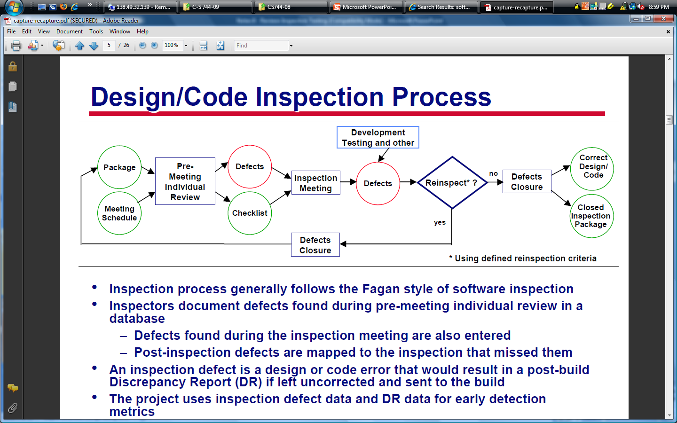
Design and Code Inspection Process – traditional process
Source: www.sei.cmu.edu/sema/pdf/capture-recapture.pdf, 2002

Slide 5
Reviews and Testing
Statistical report (2002)
1 hour review of requirements saves 3-6 hours of design review, saves 10 hours of coding review about 15-40 hours of testing
1 hour review of requirements may save up to $150 in design review and up to $10000 during delivery of the product
Totally, reviews save up to 80% of cost and time during testing

Slide 6
Reviews and Testing (continued)
 |  | Time Detected
 |  | Requirements | Architecture | Construction | System Test | Post-Release
Time Introduced | Requirements | 1× | 3× | 5–10× | 10× | 10–100×
 | Architecture | - | 1× | 10× | 15× | 25–100×
 | Construction | - | - | 1× | 10× | 10–25×
© Steve McConnell, 2004

Slide 7
Ripple Effects of Defects
Defects introduced in one stage may have serious effects on subsequent stages
E.g., A defect in requirements may creep into design and code
Defects with ripple effects become worse when detected at later stages
Cost of tracing and fixing all problems due to ripple effects would be very high

Slide 8
Ripple effect without reviews
Defects
Defects captured and corrected
Defects with ripple
New defects
50%
6
6
Project proposal
Unit testing
72
2
4 * 1
Requirement
50%
9
System testing
15
7
36
8 * 3.5
Design
50%
20
Acceptance testing
55
40
145
15 * 5
18
30
Coding
IBM project on product assurance, 1981

Slide 9
Ripple effect with reviews
Defects
Defects captured and corrected
Defects with ripple
New defects
50%
50%
3
6
Project proposal
Unit testing
14
1
2 * 1
50%
Requirement
50%
9
System testing
6
4
7
2 * 3.5
50%
Design
50%
20
Acceptance testing
15
12
28
3 * 5
50%
3.5
30
Coding
IBM project on product assurance, 1981

Slide 10
Testing Vs Quality Assurance
Testing focuses on finding defects in code
Testing is preferably planned earlier, after requirements
It is performed only after coding
Quality Assurance focuses on developing better quality products
Quality must be predefined and quality checks must be planned earlier
Quality assurance is generally performed throughout the life cycle

Slide 11
Project Manager’s Perspective of Testing and Debugging
May be able to estimate the time required for testing but it is hard to estimate the time for debugging, fixing the errors and re-testing because the origin of a defect is not known beforehand
Must use past experience, previous project results, the productivity of team members, … to correctly estimate the time for completing the testing phase

Slide 12
Types of testing
Unit testing
Programmer’s responsibility
Integration testing
Programmer’s and Project manager’s responsibility
Regression testing
Programmer’s and Project manager’s responsibility
System testing
Project manager’s responsibility
Acceptance testing
Project manager’s responsibility

Slide 13
Testing documentation
Test plan
Testing approaches to be used, tools to be used, estimated time and cost, resources to be used, …
Test case specifications
Description of test cases to be exercised
Test data
Actual test values to be applied during testing
Test log
Record each testing activity – what defect, who found it, when found, origin of defect, how fixed, re-testing information (another test log may be), …
Testing summary
An overall report of the entire testing phase

Slide 14
Exercise
Discuss the roles of
Reviews (manual reviews)
Inspection
Testing (all types)
in Scrum model. Use your project as
example.

